Slide 1
Farewell hybrid covariances: Moving to fully ensemble-derived background-error covariances for NWP at ECCC
Jean-François Caron & Mark Buehner
9th ISDA, Bologna, Italy
16 October 2023

Slide 2
introduction
Since the implementation of 4DEnVar at ECCC in 2014, the formulation uses hybrid covariances, that is a blend of flow-dependent and homogeneous and isotropic background-error covariances.
B = β_{ens} B_{ens} + β_{nmc} B_{nmc}
B-matrix weights evolution over time in our global NWP deterministic system
GDPS | β_{ens} | β_{nmc}
2014 | 0.5 | 0.5
2018 | 0.75 | 0.375
2021 | 1 | 0.25 (< 20 hPa) 0 (> 60 hPa)
2024 | 1 | 0
SDL introduction in B_{ens} as described in Caron and Buehner (2022, WAF)
Scale-dependent localization (SDL) is central in this revolution

Slide 3
EnVar with B^{1/2} preconditioning
Current (one-size-fits-all) Approach
Analysis increment computed from control vector (B^{1/2} preconditioning) using:
k: member index
Scale-dependent Approach (as in Buehner and Shlyaeva, 2015, Tellus)
Varying amounts of smoothing applied to same set of amplitudes for a given member
k: member index
j: scale index
where e_{k,j} is scale j of normalized member k perturbation
Shown to improved forecast performances in a 3DEnVar context in Caron and Buehner (2018, MWR) and Caron et al. (2019, MWR)

Slide 4
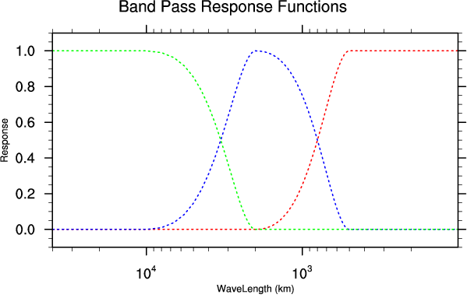
SDL configuration
Filter response functions for decomposing with respect to 3 horizontal scale ranges
10000 km
2000 km
500 km
Horizontal localization radius (km)
 | 2021 | 2024
Small | 1000 | 1000
Medium | 2400 | 2400
Large | 3300 | 3800
Large scale
Medium scale
Small scale

Slide 5
ExpEriments & scores
1.5 months against the GDPS 15-km control cycle (OPS; no SDL 0.75/0.375)
4DEnVar |  |  | Summer 2019 |  |  | Winter 2020
β_{ens} | β_{nmc} | SDL | HN | TR | HS | HN | TR | HS
0.75 | 0.375 | Yes
1 | 0 | No
 |  | Yes
1 | 0.25 | No
 |  | Yes
1.25 | 0 | No
 |  | Yes

Slide 6
Experiments & scores
1.5 months against the GDPS 15-km control cycle (OPS; no SDL 0.75/0.375)
4DEnVar |  |  | Summer 2019 |  |  | Winter 2020
β_{ens} | β_{nmc} | SDL | HN | TR | HS | HN | TR | HS
0.75 | 0.375 | Yes | +0.08 | +0.64 | +0.44 | +0.02 | +0.19 | -0.19
1 | 0 | No | -0.88 | +0.85 | +0.83 | -0.06 | +0.33 | -0.87
 |  | Yes | +0.69 | +1.29 | +0.86 | +1.11 | +0.90 | +0.10
1 | 0.25 | No | +0.25 | +0.50 | +0.43 | -0.02 | +0.22 | -0.47
 |  | Yes | +0.79 | +0.87 | +0.63 | +0.32 | +0.49 | -0.66
1.25 | 0 | No | -0.58 | +0.46 | +0.28 | +0.27 | +0.33 | -0.23
 |  | Yes | +0.86 | +1.23 | +1.06 | +1.04 | +0.71 | -0.27
Changes in total forecast quality index (in %) with respect to OPS and computed using ECMWF analyses

Slide 7
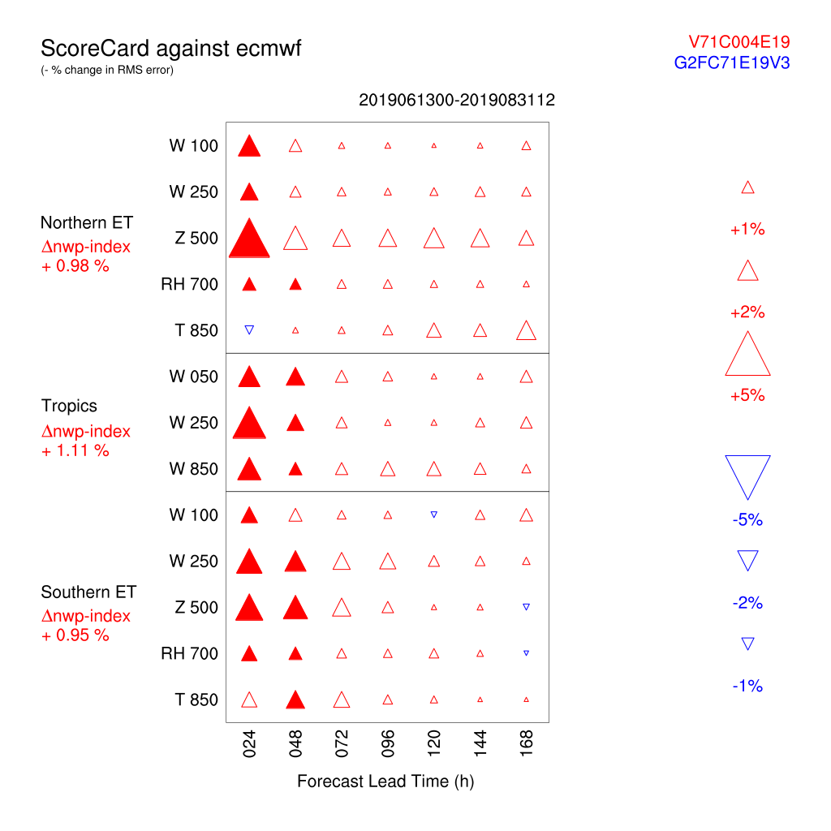
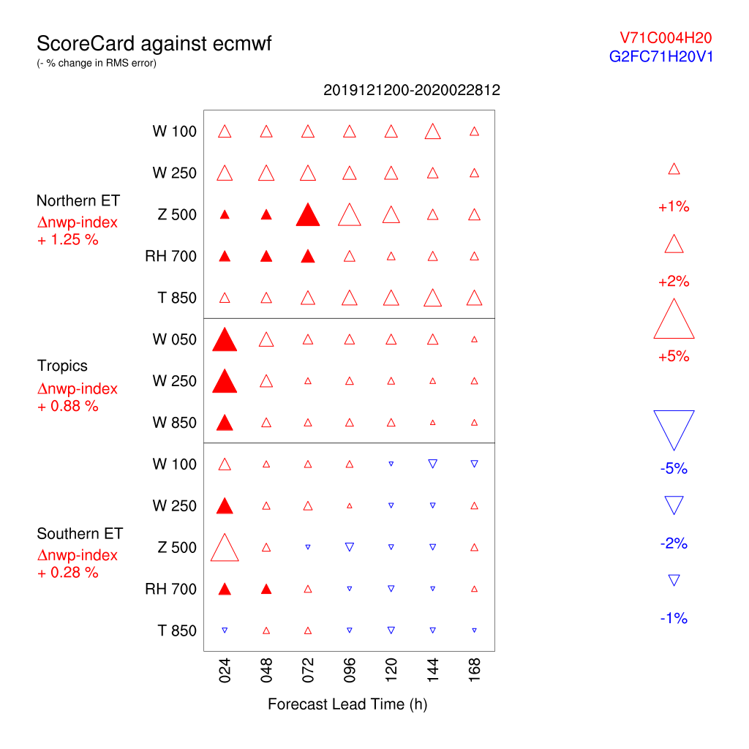
SCORecard over 2.5 months
Summer 2019
Winter 2020
100% B_{ens} & SDL
vs
OPS

Slide 8
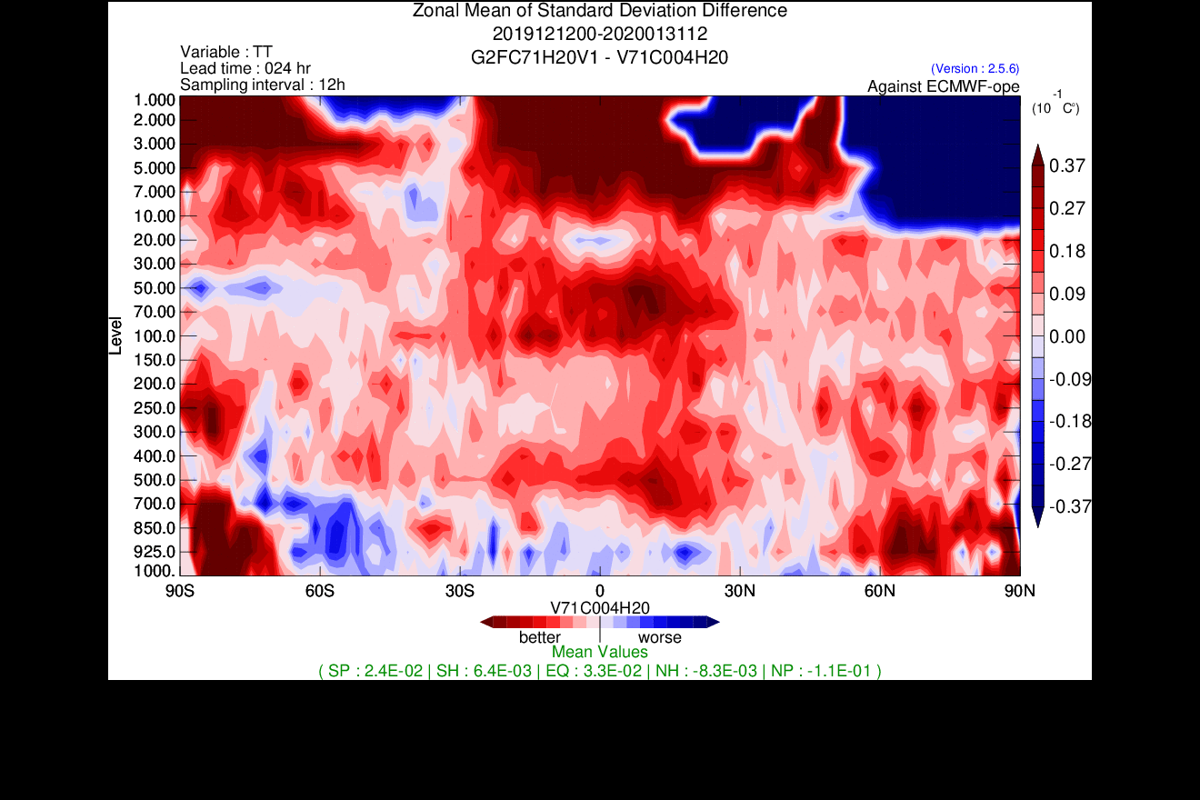
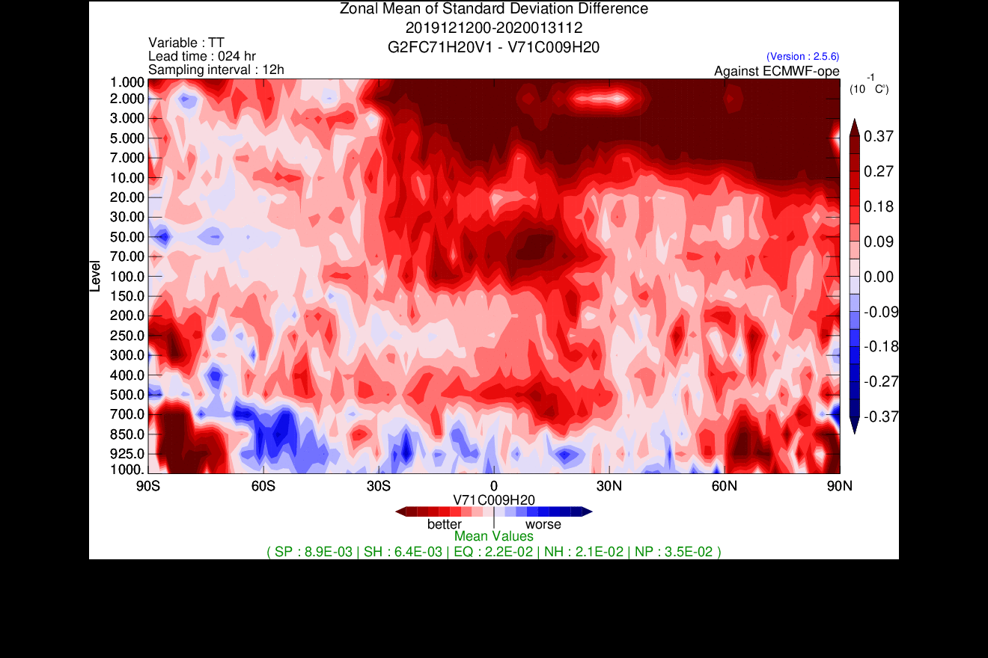
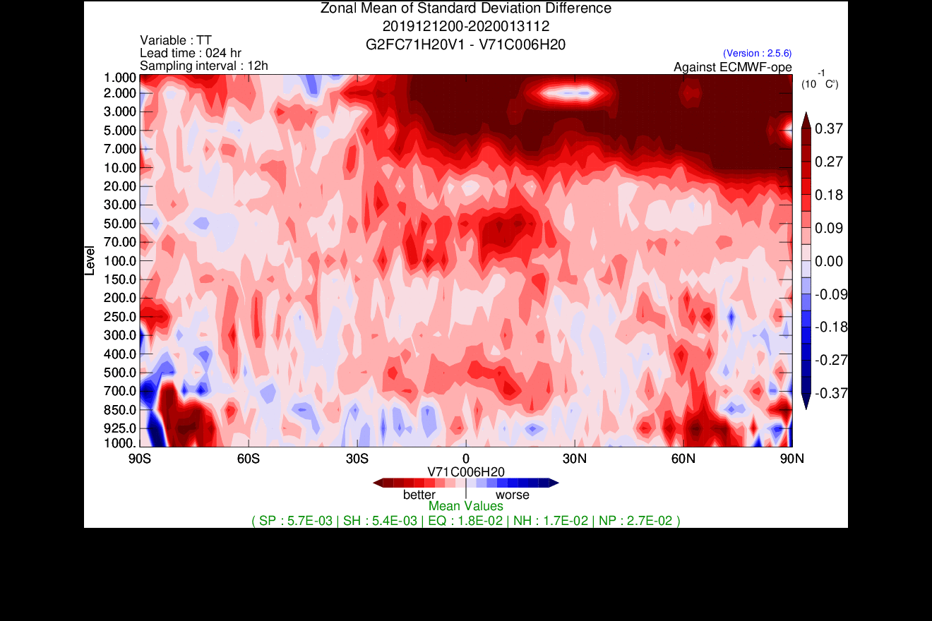
latitudinal cross-sections
Temperature STDE differences for 24h forecasts
Winter 2020 – 1.5 months
100% B_{ens} & SDL
vs
OPS
100% B_{ens} & SDL + 25% B_{hi} only < 20 hPa
vs
OPS
100% B_{ens} & SDL + 25% B_{hi}
vs
OPS

Slide 9
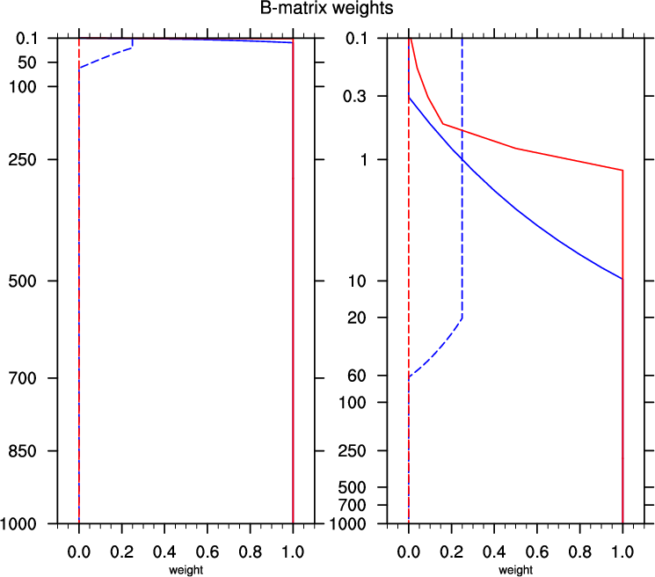
Reduce tapering near the lid
To avoid triggering some instabilities near the model lid, we taper the variances of both B_{nmc} and B_{ens}
Tapering of B_{nmc} is done in the matrix computation step while the tapering of B_{ens} done by adjusting β_{ens}
IC-3 (2021)
IC-4 (2024)
β_{ens}
After the 2021 implementation of SDL, it was found that variances tapering of B_{ens} was too severe and explained why deteriorations were found in the upper stratosphere without a contribution from B_{nmc}
β_{nmc}

Slide 10
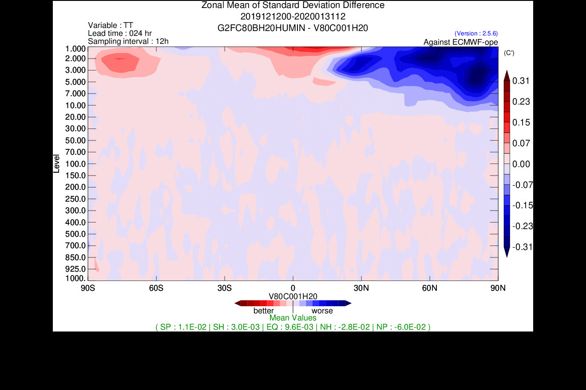
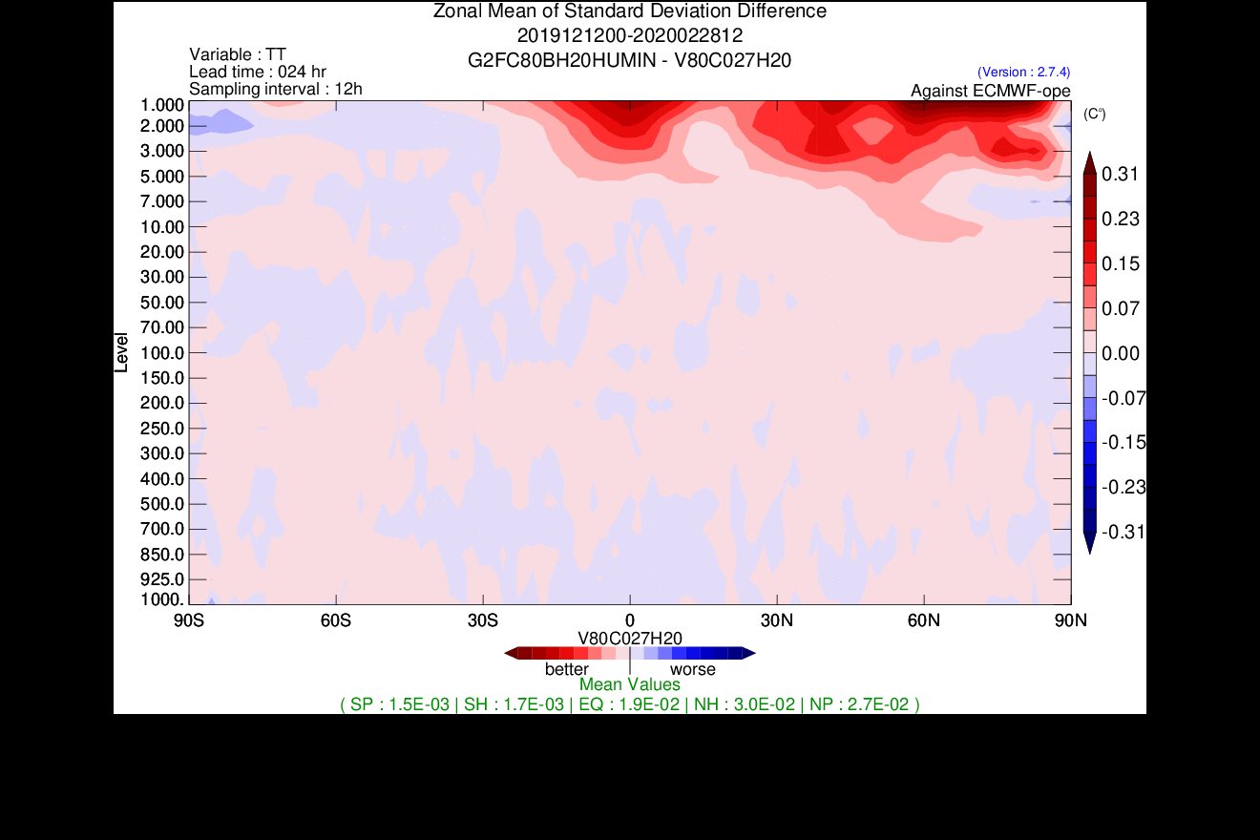
Reduce tapering near the lid
Temperature STDE differences for 24h forecasts
Winter 2020 – 2.5 months
100% B_{ens} with legacy tapering vs IC-3
100% B_{ens} with reduce tapering vs IC-3

Slide 11
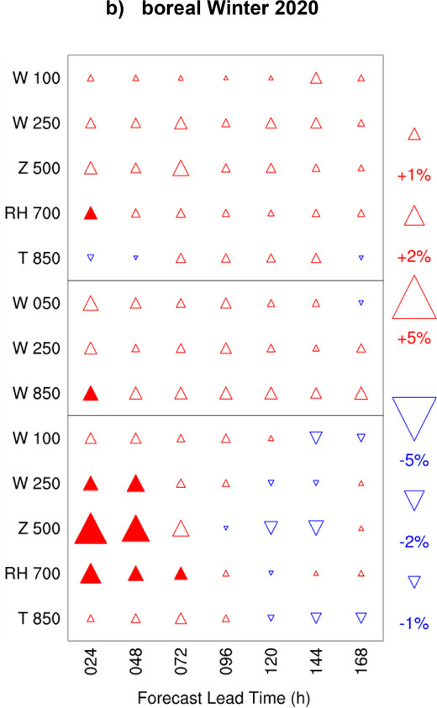
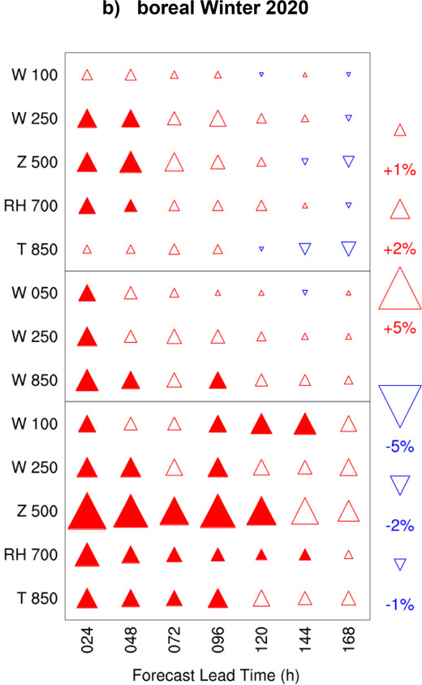
Leveraging ensemble improvements
OPS pre 2021 & newEns
vs
OPS pre 2021 & oldEns
OPS since 2021 & newEns
vs
OPS since 2021 & oldEns
Relying more on ensemble-derived covariances amplifies the positive impacts when the background ensemble generation strategy is improved
Winter 2020

Slide 12
Hybrid-gain approach in EPS
We revisited the hybrid-gain approach after introducing SDL and purely ensemble-derived covariances in the EnVar used in our global ensemble system.
$$x_{i,hyb}^{a}=x_{i,LETKF}^{a}+γ \left(x_{EnVar}^{a}− \overline{x_{i,LETKF}^{a}}\right)$$
GEPS | 𝛾
2019 | 0.5
2021 | [0,1]
2024 | 0.5 < 50 hPa 0.75 > 100 hPa
𝛾 = 1 : the analyses are centered on the EnVar analysis
𝛾 = 0 : no recentering takes places
New optimal coefficients
It is unclear why hybrid-gain has still a positive impact (especially in the stratosphere) given the limitations in the current LETKF:
The LETKF algorithm treats radiances as local observations rather than integrated ones as in the EnVar
The LETKF assimilates less radiances than the EnVar
The absence of SDL in the LETKF

Slide 13
Summary and conclusions
Implementing the SDL formulation of Buehner and Shlyaeva (2015) in our 4DEnVar scheme eliminated any benefit from including static covariances
All three NWP systems relying on 4DEnVar at ECCC (GDPS, GEPS and HRDPS) will be using fully ensemble-derived background-error covariances from 2024, bringing many benefits:
Reduces the maintenance burden of our systems. Tuning and adapting B_{nmc} for system changes is/was not straightforward.
Maximise the forecasts improvements when upgrading the ensemble system.
Facilitates the extension of the analysis step to hydrometeors and other highly flow-dependent variables.
However, SDL on its own is not sufficient to move away from hybrid-gain in our global EPS

Slide 14
Extension of SDl in the vertical
So far, we have only tested and implemented horizontal-scale-dependent horizontal localization.
But vertical-scale-dependent vertical localization is possible and would lead to horizontal-vertical SDL.
hLoc-small vLoc-large | hLoc-medium vLoc-large | hLoc-large vLoc-large
hLoc-small vLoc-medium | hLoc-medium vLoc-medium | hLoc-large vLoc-medium
hLoc-small vLoc-small | hLoc-medium vLoc-small | hLoc-large vLoc-small
hLoc-small vLoc | hLoc-medium vLoc | hLoc-large vLoc
Vertical scale
Vertical scale
Horizontal scale
Horizontal scale

Slide 15
Extension of SDl in the vertical
Explored idea: Perform vertical scale decomposition using the eigen vectors of a correlation matrix

Slide 16
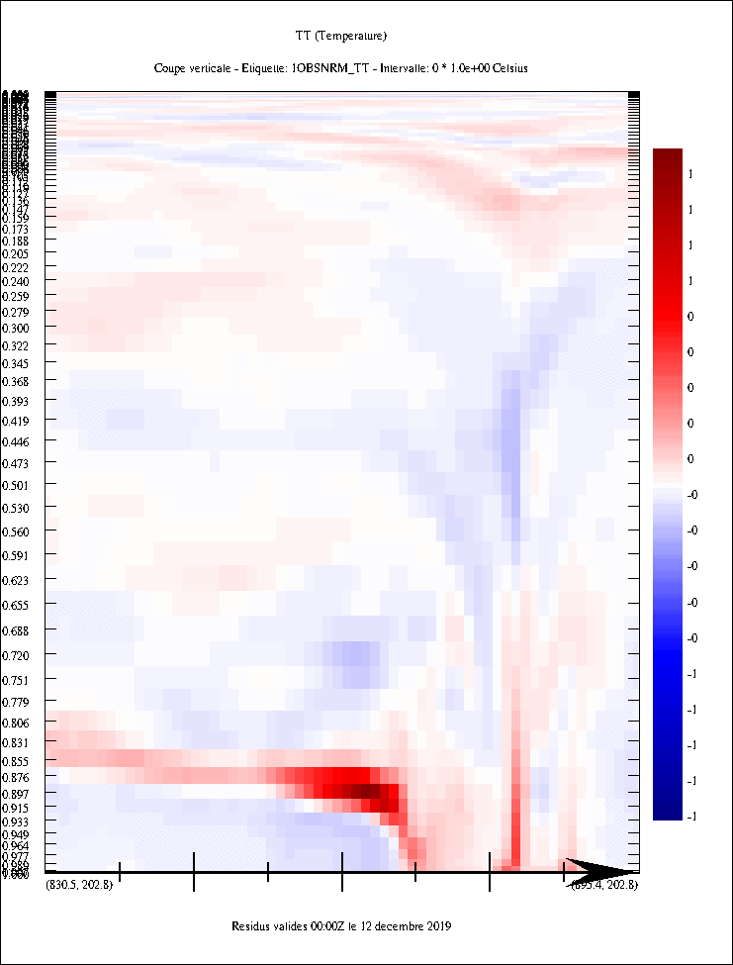
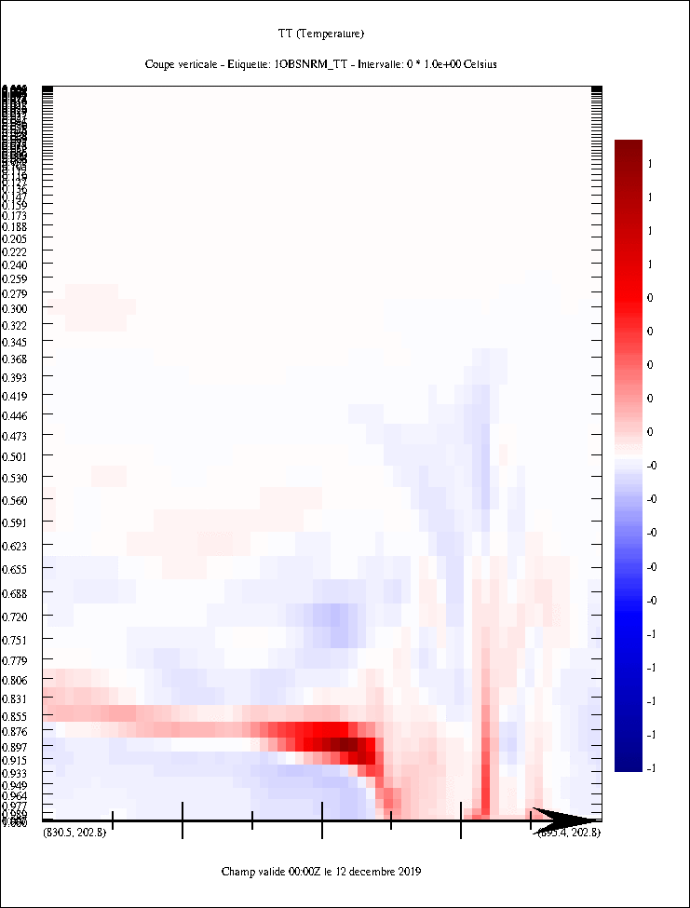
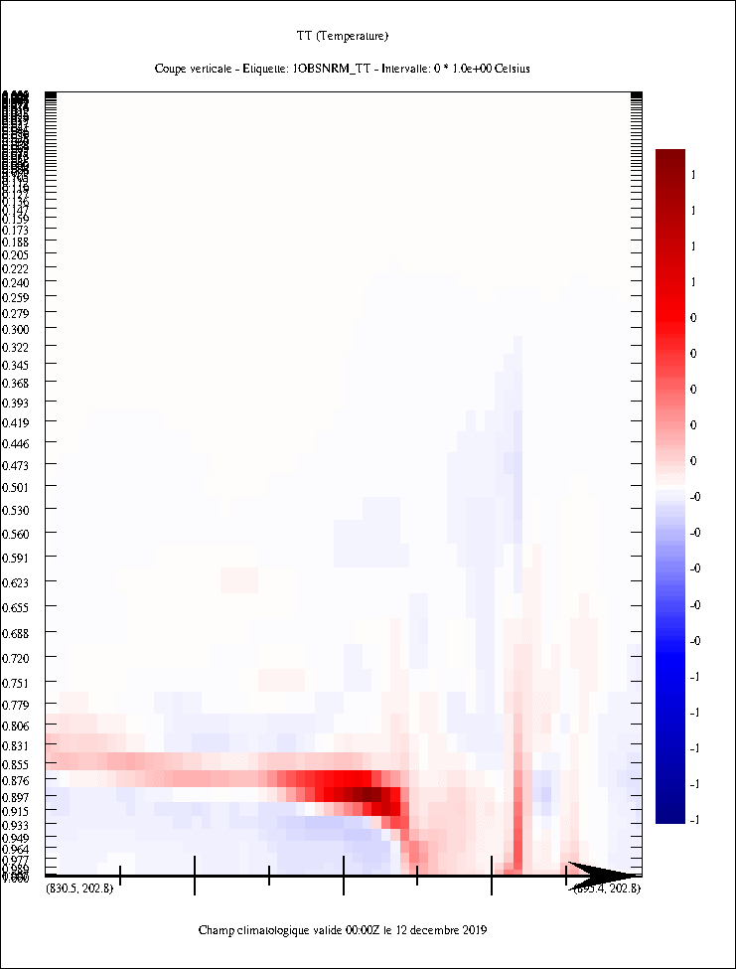
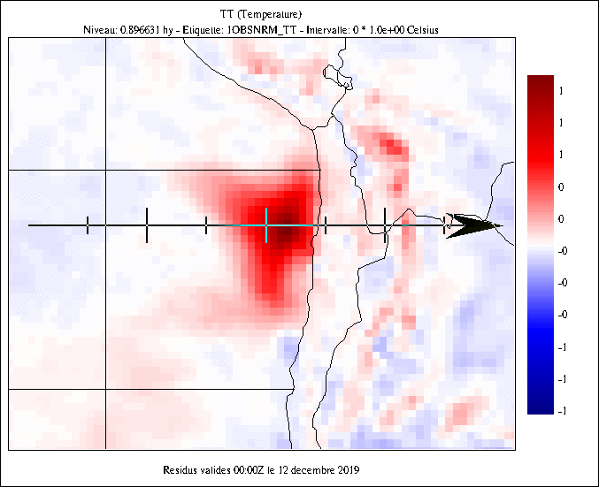
Extension of SDl in the vertical
Preliminary results where stratiform and convective events take place next to each other
B_{ens} No Loc
B_{ens} Std vLoc
B_{ens} vSDL vLoc
vLoc: 2 ln(p)
vLoc: 0.5 / 2 / 4 ln(p)
900 hPa T observation in a stratocumulus area
Normalized temperature increments (correlation-like) resulting from various B matrices.

Slide 17
EXTRA

Slide 18
Timings & computational costs
Comparison of computational resources used on a CRAY XC-50 for the variational analysis program in the GDPS 4DEnVar configuration with and without the three wave bands SDL.
x 2.25
The cost is simply defined as the product of the wall clock time and the number of cores used.

Slide 19
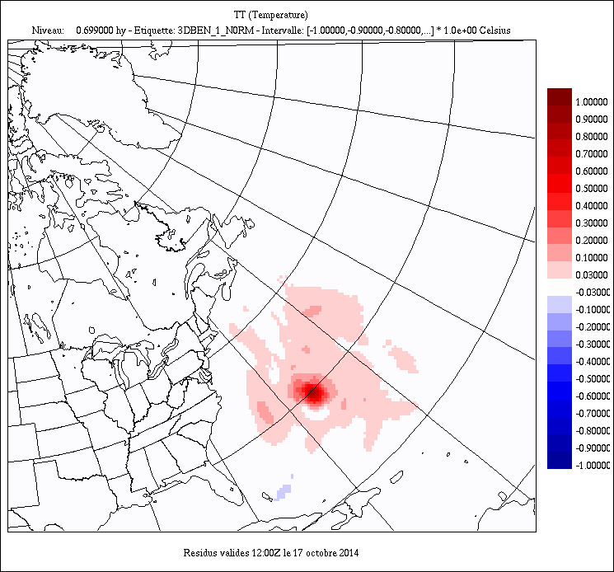
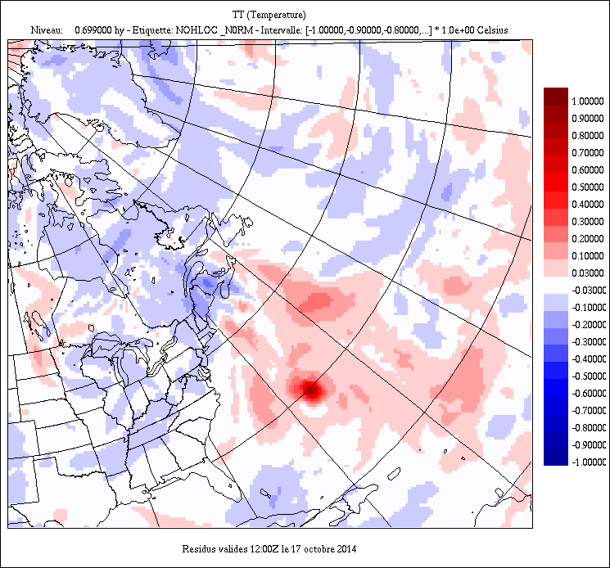
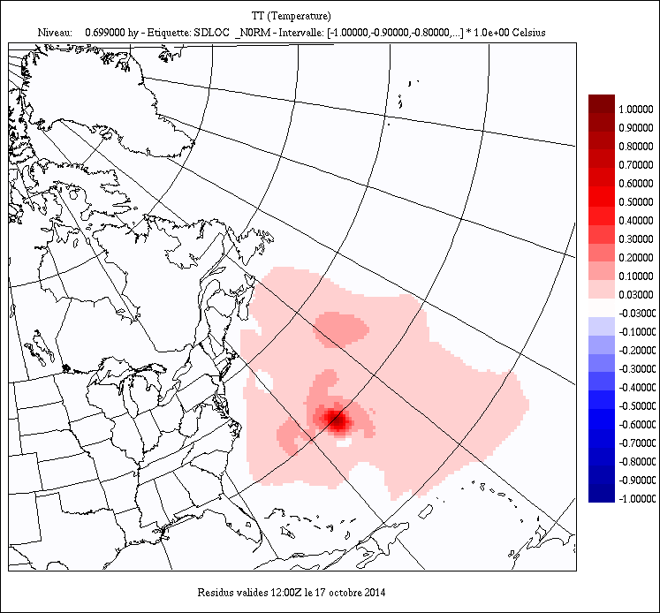
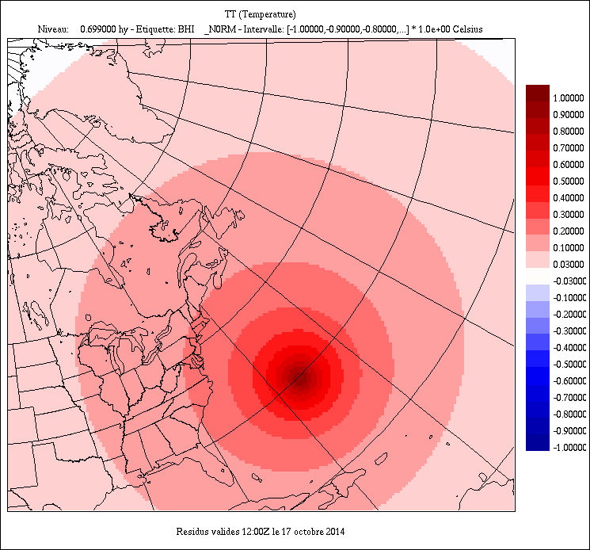
Scale-dependent localization (SDL)
Impact in single observation DA experiments
B_{ens} Std hLoc
B_{ens} No hLoc
700 hPa T observation at the center of Hurricane Gonzalo (October 2014)
+1
+1
0
0
-1
-1
hLoc: 2800km
B_{ens} SDL hLoc
B_{nmc}
+1
+1
Normalized temperature increments (correlation-like) at 700 hPa resulting from various B matrices.
0
0
-1
-1
hLoc: 1500km / 4000km / 10000km

Slide 20
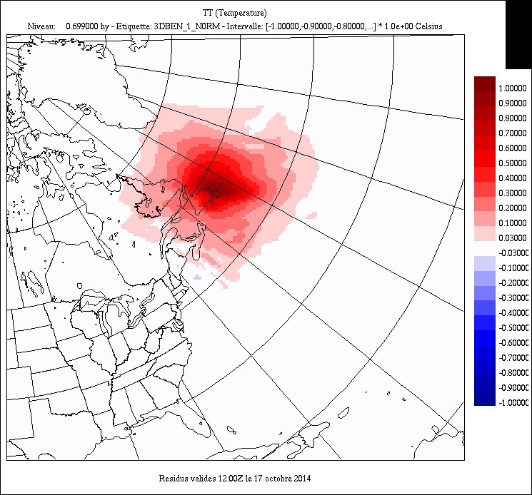
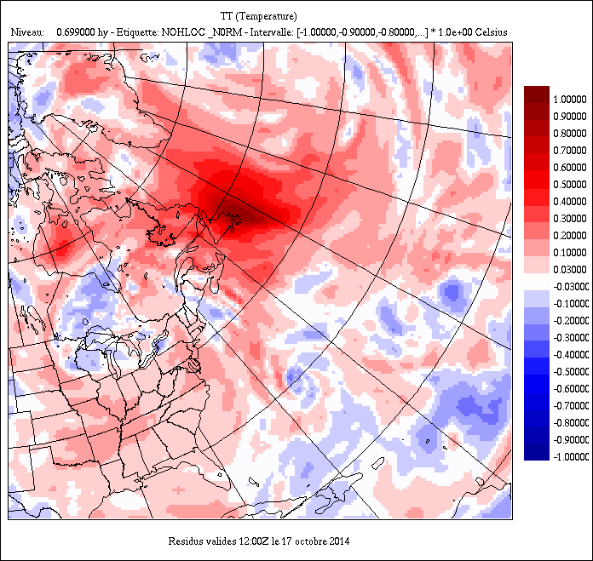
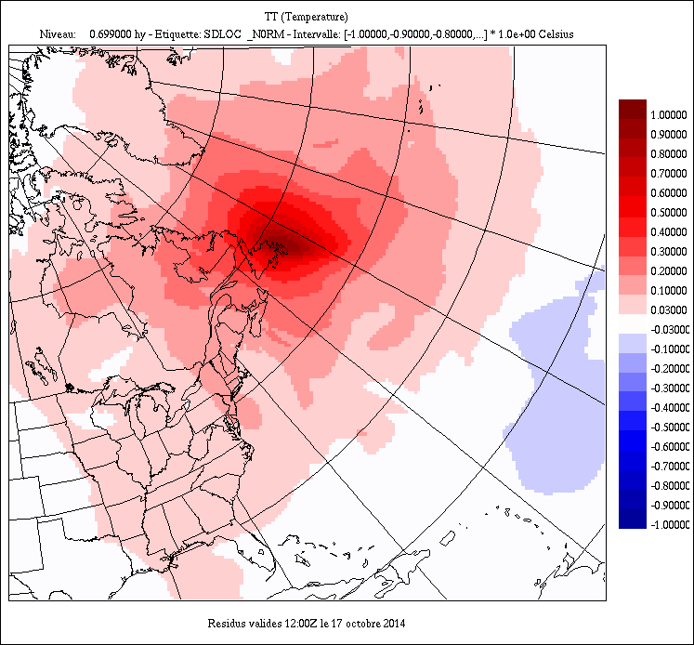
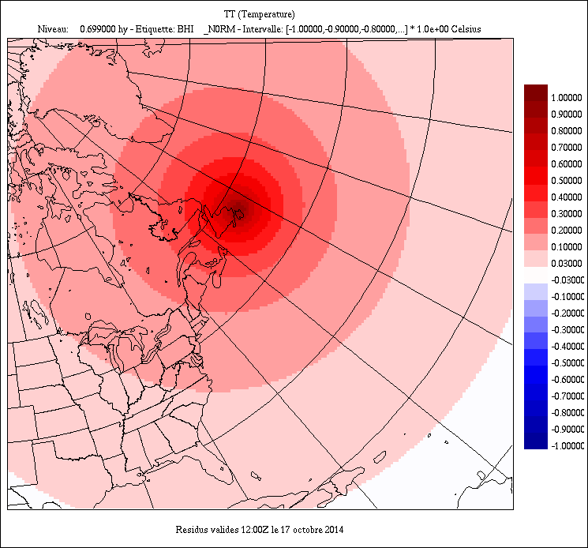
Scale-dependent localization (SDL)
Impact in single observation DA experiments
B_{ens} Std hLoc
B_{ens} No hLoc
700 hPa T observation at the center of a High Pressure
+1
+1
0
0
-1
-1
hLoc: 2800km
B_{ens} SDL hLoc
B_{nmc}
+1
+1
Normalized temperature increments (correlation-like) at 700 hPa resulting from various B matrices.
0
0
-1
-1
hLoc: 1500km / 4000km / 10000km

