Slide 1
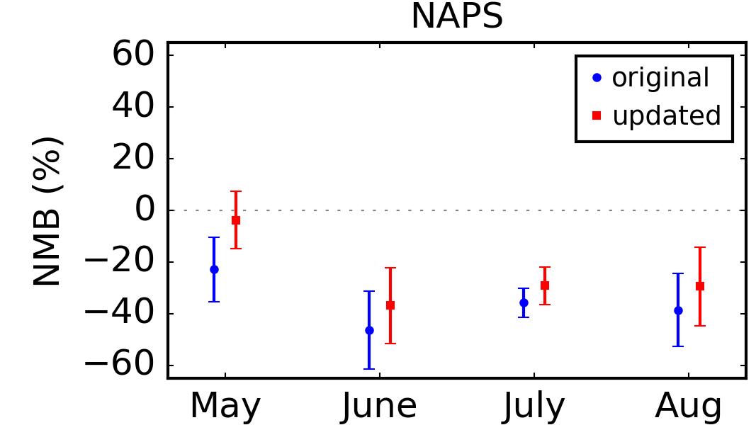
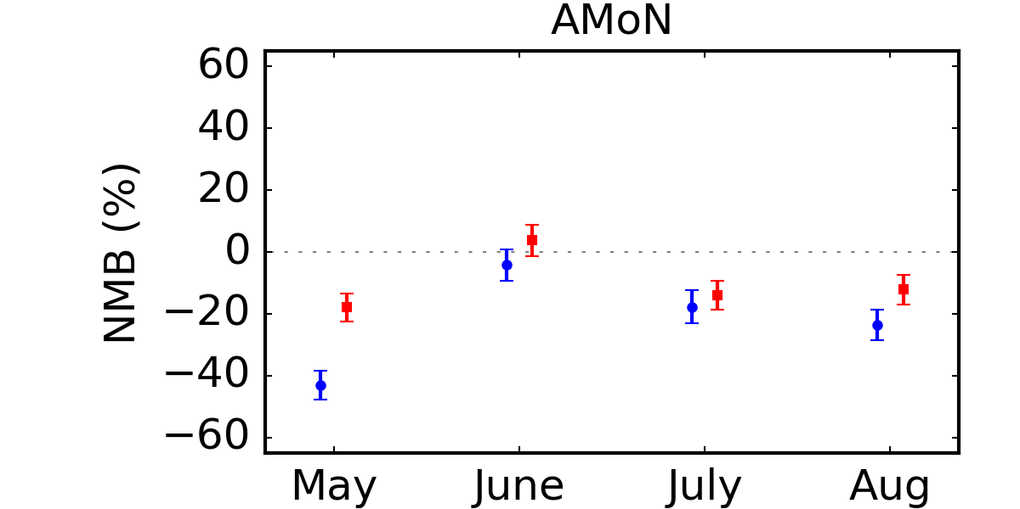
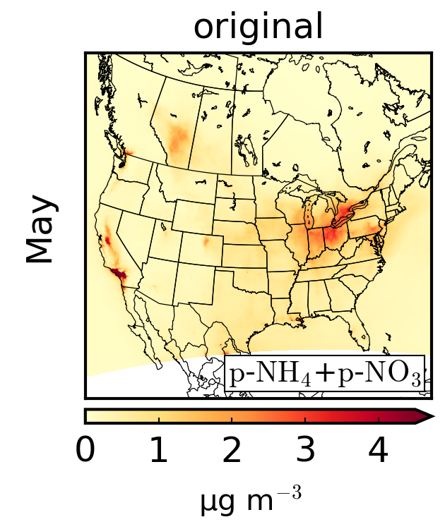
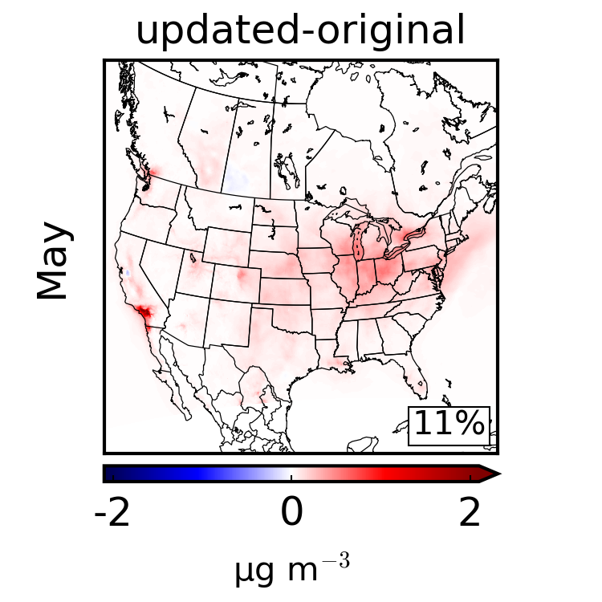
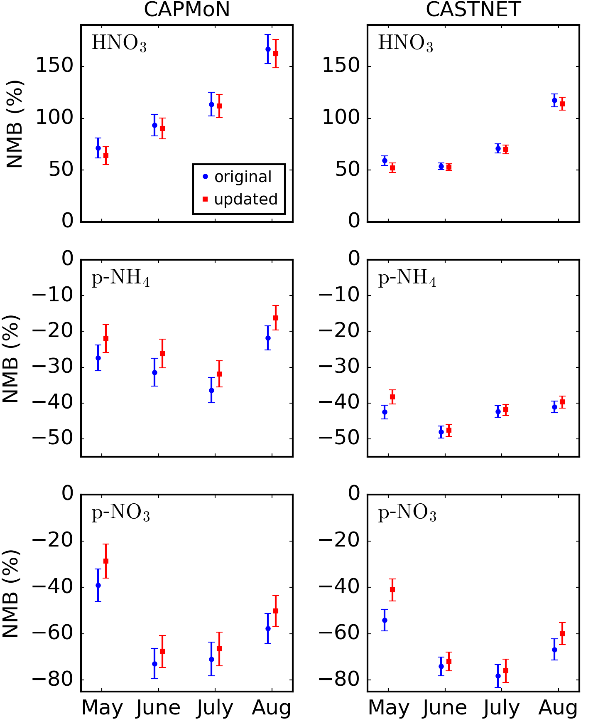
Ensemble-Variational Inversion System for Estimating Ammonia Emissions using CrIS Ammonia Retrievals
Michael Sitwell, Mark W. Shephard, and Yves Rochon
Air Quality Research Division, Environment and Climate Change Canada, Toronto, Ontario, Canada
Ammonia Emissions
Atmospheric Ammonia
Primary atmospheric basic gas, important for particulate matter formation
Short atmospheric lifetime (hours to days)
Significant agricultural emissions (fertilizers and livestock)
Estimating ammonia emissions
NH₃ field is spatially very inhomogeneous
In situ measurements can be challenging
Satellite observations relatively new
Large uncertainties on emissions
CrIS ammonia retrievals
Ammonia retrievals available from instruments aboard S-NPP (2012-2021) and NOAA-20 (2019-present)
Local overpass times at approximately 01:30 and 13:30
Ensemble-Variational Inversion
NH₃ emissions inventory
emissions 1
emissions ensemble
emissions-concentration background covariances
Goal: Refine NH₃ emissions needed for the GEM-MACH air quality model
Perform inversions for monthly mean ammonia emissions
Use pre-existing time profiles to map monthly emissions to hourly emissions for use in GEM-MACH
Ensemble-based variational inversion system
Flow-dependent background error covariance
Does not require the model adjoint
100 member ensemble with perturbed monthly mean NH₃ emissions
emissions 2
emissions 3
GEM-MACH
GEM-MACH
$$⋱$$
CrIS retrievals
CrIS - GEM-MACH
emissions increment
NH₃ total column
inversion
Inversion Results
Monthly mean ammonia emission inversions for May to August 2016
The inversion increases NH₃ emissions in most of the model domain
Changes in surface ammonia
Inversions reduce underprediction of modeled surface NH₃ as compared to surface observations
NH₃ emissions increments
updated - original
May
July
+ 28%
+ 59%
+ 65%
+ 62%
May
July
8
mean bias (%)
June
August
+ 46%
+ 5%
+ 8%
+ 17%
August
0
ppbv
June
-8
mean bias (%)
change over model domain
change over model domain
Impact on Particulate Matter Formation
Change in total ammonium/nitrate surface concentrations
Comparison with observations
Some reduction in ammonium/nitrate underprediction as compared to surface/precipitation observations
CAPMoN
CASTNET
change over model domain
mean bias (%)
mean bias (%)
total surface ammonium + nitrate
Conclusions
While large uncertainties exist in NH₃ emission inventories, emission inversions with CrIS NH₃ retrievals can greatly reduce these uncertainties
Ensemble-based inversions are an effective method that does not require a model adjoint
Inversions yield better agreement with surface observations
NH₃ inversions can have a significant impact on PM formation
Ensembles can be computationally expensive to run
Published in Sitwell, Michael, et al. "An ensemble-variational inversion system for the estimation of ammonia emissions using CrIS satellite ammonia retrievals." Atmospheric Chemistry and Physics 22.10 (2022): 6595-6624.
9th International Symposium on Data Assimilation - October 16-20, 2023 - Bologna, Italy

