Slide 1
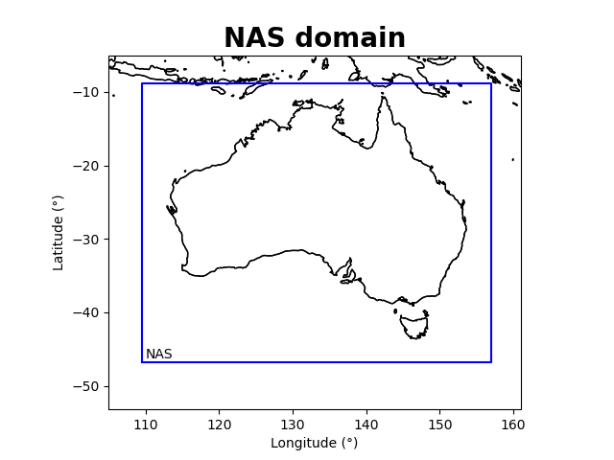
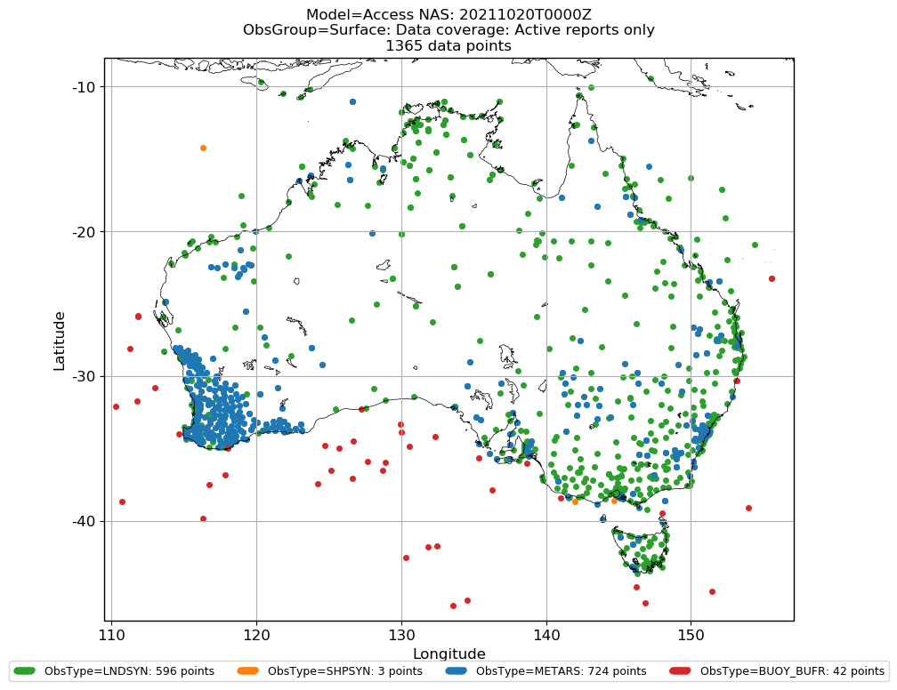
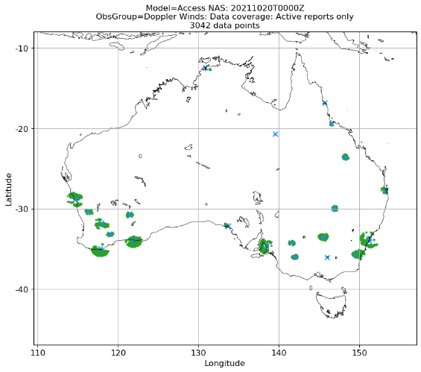
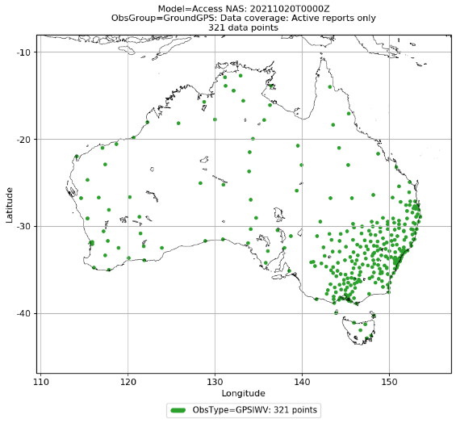
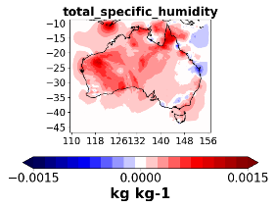
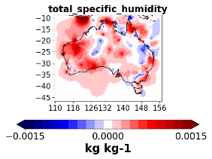
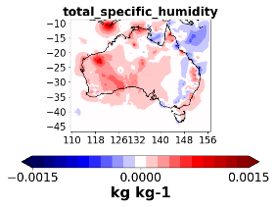
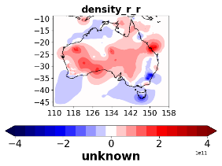
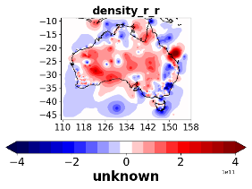
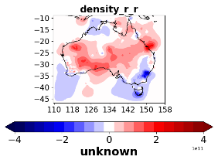
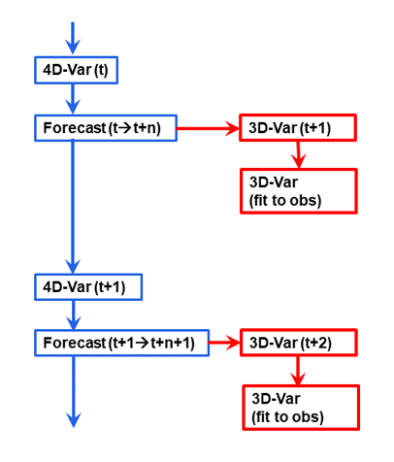
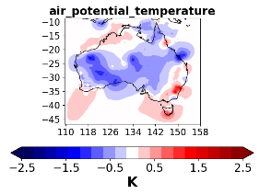
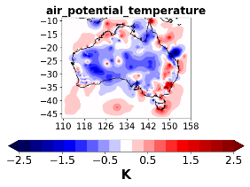
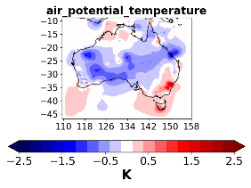
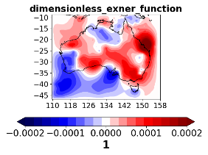
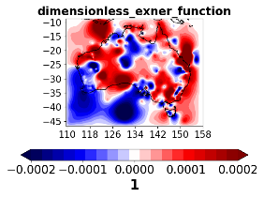
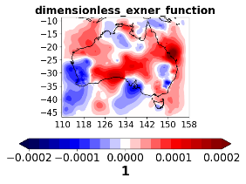
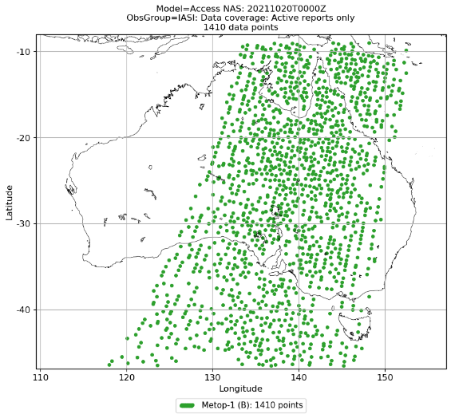
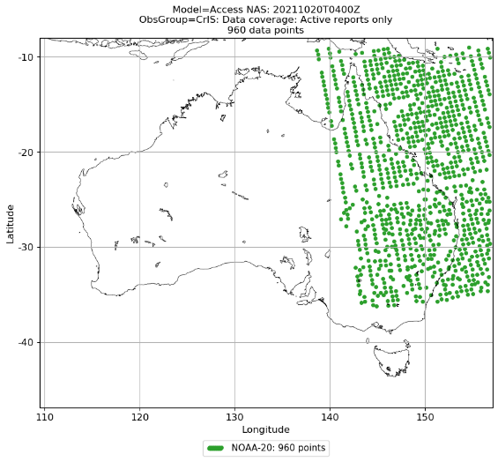
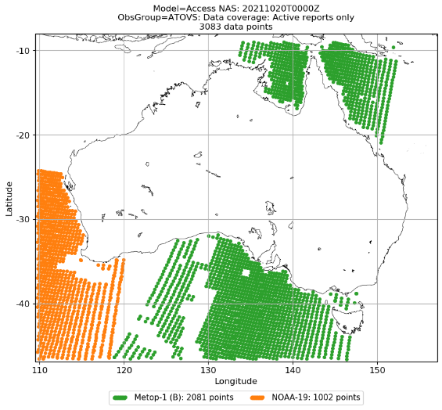
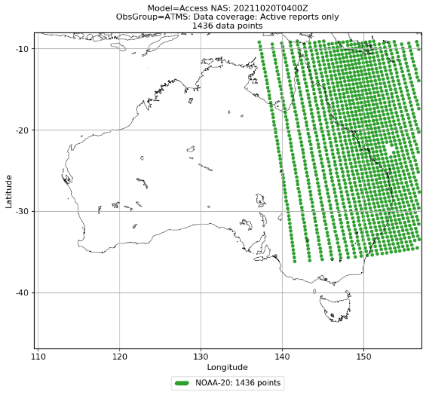
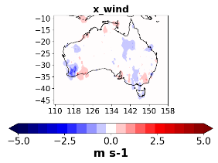
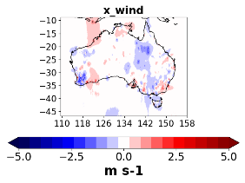
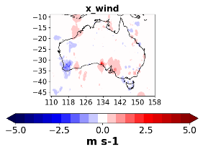
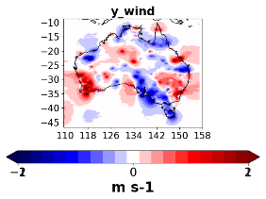
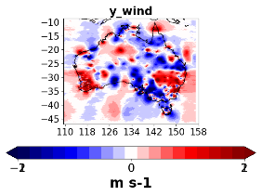
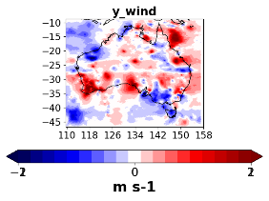
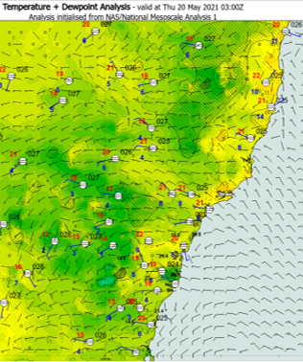
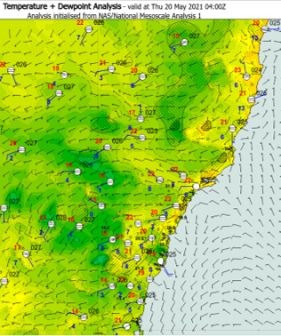
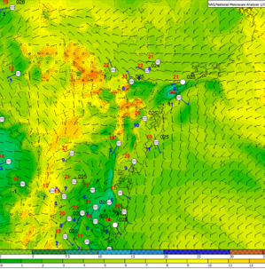
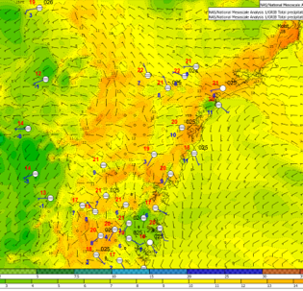
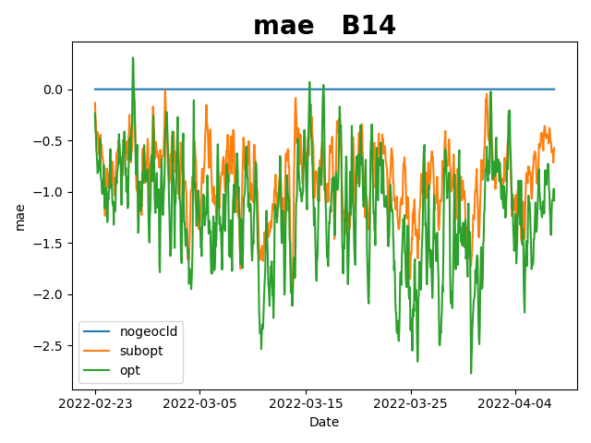
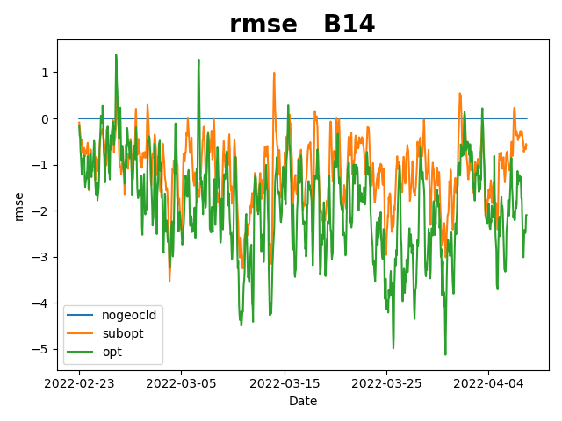
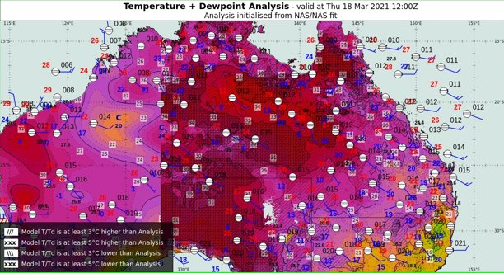
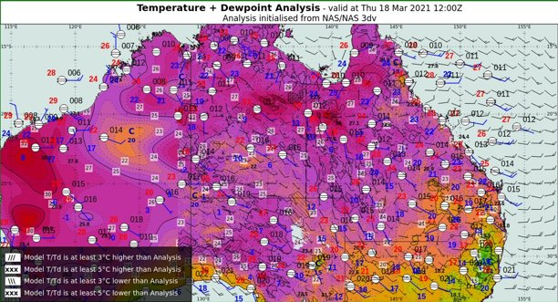
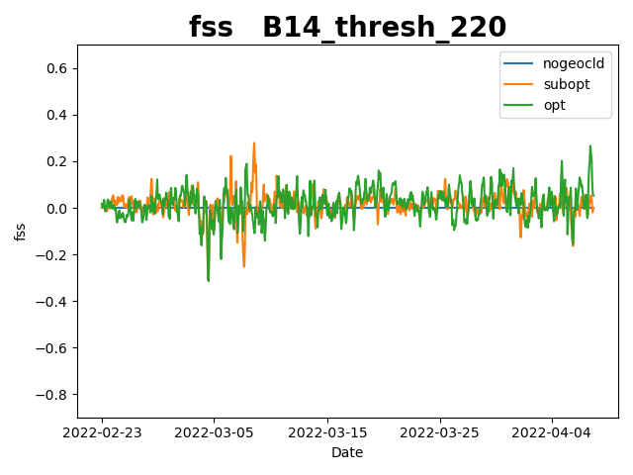
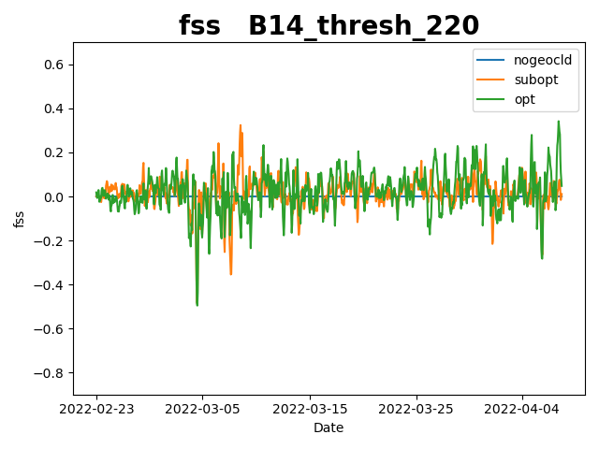
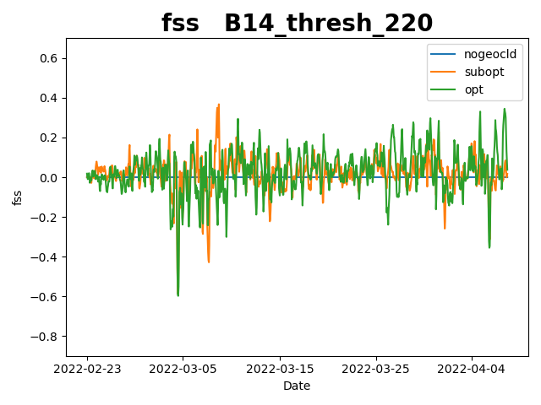
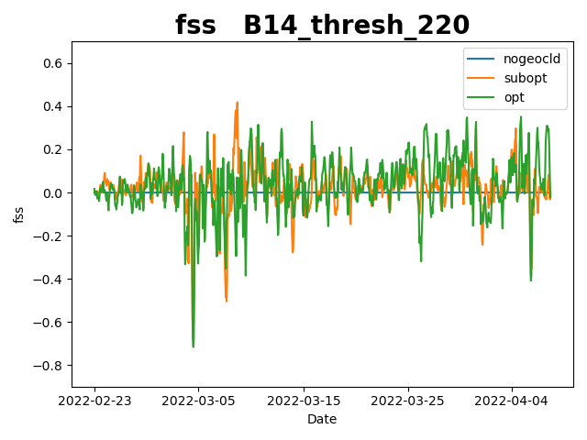
National Analysis System for Australia
Objectives of National Analysis System:
enhance situational awareness of operational forecasters
contribute to nowcasting of severe weather events
support automated weather forecasting and reduce discrepancies between broadcast and actual weather
Monika Krysta, Peter Steinle, Susan Rennie, Jin Lee, Imtiaz Dharssi, Tony Bannister, Ilia Bermous, Andy Smith, Tan Le, Thomas Coleman, Simon Benson, Nahidul Samrat, Fiona Smith
Bureau of Meteorology
Monika.Krysta@bom.gov.au
Conclusions:
NAS performs very well in terms of wind representation
NAS product leads to smallest RMSEs
RMSEs in NAS are comparable to the existing system Mesoscale Surface Analysis System
Description of the National Analysis System
Analysis increments
Observations
National Analysis System (NAS) has been developed to enhance the situational awareness of operational forecasters. NAS will contribute to the nowcasting of severe weather events and automated weather forecasting. NAS will also reduce discrepancies between weather forecasts as presented on the Bureau's media and the actual weather.
Performance of the three analyses implemented in NAS had been assessed. A comparison between 3D-Var, 3D-Var overfit (main NAS product) and 4D-Var analyses is presented in the below table. First observation one can make is that 3D-Var and 4D-Var analysis increments look similar, the main difference being the presence of increments over the ocean in the latter case as the extended cut-off time allows for satellite radiances to arrive and be processed.
The National Analysis System makes use of the observations traditionally assimilated into NWP models. These comprise surface, upper air, radar and satellite observations. Specifically, NAS assimilates in-situ observations from synoptic stations, aircraft data, sondes, wind profilers as well as satellite radiances, atmospheric motion vectors, scatterometer winds, Doppler radial winds and radar reflectivities, ground-based GPS. Novelty resides in assimilation of GeoCloud, which uses cloud top pressure and effective cloud amount (the product of cloud fraction and cloud top emissivity).
The NAS domain covers Australia's mainland with Tasmania and nearby waters. The entire domain is covered with 2400x1920 grid boxes constituting a regular lat-lon grid of grid spacing of 2.2km. Data assimilation is performed at a coarser resolution of 6.6 km. Vertical discretisation spans 40 levels extending to the height of 38.5 km
Field | 3D-Var | 3D-Var overfit | 4D-Var
Total specific humidity
Density*r*r
Air potential temperature
Dimensionless Exner function
X_wind
Y_wind
NAS is an hourly cycling suite. Atmospheric analyses in NAS are generated using variational data assimilation. Incremental 4D-Var is used to generate initial conditions for the forecast. The resulting analysis increment is added to the past forecast, generating initial conditions for the next one. NAS has supplementary features which consist in additional variational analyses. A deliberate choice has been made to use three-dimensional (3D-Var) analyses due to their low computational cost.
Network coverage for surface-based
conventional observations: temperature,
pressure, humidity and wind velocity
Network coverage for Doppler
weather radars: winds
and reflectivities
Network coverage for ground-based GNSS stations (Zenith Total Delay)
Satellite observations
NAS directly assimilates radiance observations from infrared sounders IASI and CRiS and from microwave sounders ATMS and AMSU. In addition, NAS also assimilates Himawari-8 AHI clear sky radiances. Moreover, Atmospheric Motion Vectors (AMVs) are generated based on Himawari-8 imagery. Another observation type arising from satellite detection are scatterometer winds, retrieved from MetOp-B and MetOp-C.
For each cycle they run in two steps. The role of the first one is to produce an analysis that is closer to dynamic balance and adjusts the larger to medium scales. The second one represents details at the observation locations by drawing the analysis towards the observations The latter is specific to NAS, referred to as 3D-Var overfit and, after being post-processed, it constitutes NAS' main product.
In addition to atmospheric data assimilation, NAS employs land surface data assimilation to produce high quality fluxes from the land to the atmosphere so that soil temperature and soil moisture are regularly updated. The methodology employs a Simplified Extended Kalman Filter-based scheme that assimilates bias corrected measurements of surface soil wetness from satellite-based microwave sensors as well as pseudo-observations of 2 m temperature and humidity. The pseudo-observation innovations are analysis increments produced by the 4D-Var atmosphere analysis.
IASI. Example of observation coverage
CRiS. Example of observation coverage
ATOVS. Example of observation coverage
ATMS. Example of observation coverage
The same observation types can, in principle, be assimilated for all three analyses, the difference being the cut-off time – consequently, 4D-Var assimilates more observations than its 3D predecessors and so, for example, ground-based GPS data, are only assimilated in 4D-Var due to their latency.
Examples of subjective assessment
Objective assessment
Verification of GeoCloud with METplus
Sydney wind change on 20th May 2021 at 04:10 UTC
There are two main obstacles to objective verification of the analysis system. The first one is a lack of appropriate tools, which are generally focussed on verification of forecasts and not analyses. The second one resides in the lack of independent observations against which we could verify as they contributed to generation of the analysis.
Three instances of NAS were run for a period of floods in Queensland in early 2022: control, which did not assimilate Geocloud, a trial in which GeoCloud assimilation was performed in a sub-optimal setting and an experiment in which GeoCloud was assimilated in an optimal setting. The suboptimal configuration used older background error covariances as opposed to using 1D and 3D background error covariances estimated from a downscaler in the optimal setting.
A change in wind direction from westerly to southerly affected southern New South Wales. The wind change was detected by Observatory Hill AWS (Sydney) and was caused by a cold front clipping south-eastern Australia, which then moved up the coast and eventually affected the Sydney region.
03 Z
Illustrated in these plots are NAS analyses at 03Z (left; before the wind change) and at 04Z (right; when it is taking place). The wind change is visible in the regions encircled with red ellipses and coincides very well with the observation time.
04 Z
One way to partly circumvent the problem is to make appeal to cross-validation. It consists in withholding a small subset of (surface) observations from assimilation and verifying against them. The number of withheld observations needs to be small so that the impact on the quality of the analysis is limited. In practice we withhold observations from 15 stations in each cycle, which is roughly 2.5% of surface observations available. We perform this in 8 experiments, 4-day long each (6th January 00Z – 9th Jan 23Z 2022), equivalent of one month simulation.
An assessment against surface observations is not necessarily the best option. Therefore, we decided to assess the impact by assessing the outputs of a radiance simulator. The radiance simulator produces reflectances and brightness temperatures for Himawari-8 channels. The gridded fields produced by NAS and Himawari-8 observations are compared using METplus.
06 Z
The plots illustrate short-term forecasting capability and good agreement between 06Z analysis (left) and 4hr forecast issued at 02Z and valid at the same time (right). The forecast comes from the time before the wind change occurred.
06 Z
Field | 3D-Var | NAS | MSAS | 4D-Var
Dew point [deg C] | 2.10 | 1.99 | 1.7 | 2.16
Meridional wind [m/s] | 1.89 | 1.84 | 1.7 | 1.87
Relative humidity [%] | 8.34 | 8.16 |  | 8.40
Screen temp [deg C] | 1.39 | 1.31 | 1.5 | 1.42
Station pressure [hPa] | 0.58 | 0.53 |  | 0.58
Wind direction [deg] | 47.27 | 46.78 |  | 46.50
Wind speed [m/s] | 1.94 | 1.89 |  | 1.97
Zonal wind [m/s] | 1.89 | 1.87 | 1.7 | 1.89
Mean absolute error and root mean squared error were produced for all 10 brightness temperature channels. They indicate that the performance of the optimized experiment run outperformed the other two instances of NAS.
The optimized configuration produces lowest values of error. The illustration is for one of the atmospheric window channels but the results are similar for other infra-red channels.
New South Wales floods: 17th March 18Z – 25th March 23Z 2021
Secondly, neighbourhood statistics were computed. These consist of fractions Brier score (FBS) and fractions skill score (FSS). They involve an arbitrary definition of a cut-off threshold re-defining the analysed quantities into a binary field. They are performed within a neighbourhood of a certain size around each grid point. Different threshold values and neighbourhood sizes were tested. The statistics performed reasonably well. FSS, having an optimal value of 1, increases with an increasing neighbourhood size. This is the expected performance since the increased neighbourhood size relaxes the location error and produces more favourable outputs for large neighbourhoods.
The large stationary blocking high-pressure system to the southeast of Tasmania allowed low-pressure systems to move up from the Bight to affect New South Wales during the period. The combination of onshore moisture from a high-pressure system in the Tasman Sea and a low-pressure system in the Timor Sea resulted in exceptionally high daily rainfall totals in eastern and south-eastern Australia on multiple days during the event.
Without land surface data assimilation
With land surface data assimilation
The results of the cross-validation experiment for three NAS analyses alongside the current operational Mesoscale Surface Analysis System (MSAS) are shown in this table. Generally, the smallest RMSEs are for the NAS product.
Temperature and dewpoint analysis illustrating importance of land surface data assimilation: without it (left) temperatures higher than observations while with it (right) temperature better match observations.
Time series of Fractions Skill Score for three GeoCloud experiments and different neighbourhood sizes (1, 25, 51, 101).
Future work
4. Novel approaches to assimilation of bounded variables
Addition of new observation types:
third-party observations
drones
Estimation of observational impact on the quality of the analysis by assessing reduction of uncertainty in the analysis
Further tuning of the observation error variances so that NAS product is fit for purpose
Incorporation of ensembles into NAS in the form of:
ensemble-based background error covariances and 3DEnVar with appropriate localisation schemes
ensemble data assimilation
Expanding control variables to include those relevant for the convective scale, namely hydrometeors
7. Increase frequency of updates of analyses from 1h to 30min, maybe even 15 min
8. Incorporation of NAS functionalities into a newly developed limited-area modelling system and use its 4D-Var analysis as a background in NAS
References
3. . Rennie S., Cooper S., Steinle P., Dietachmayer G., Krysta M., Franklin C., Bridge C., Marshall M., Xiao Y. and Sgarbossa, D.: ACCESS-C: Australian Convective-Scale NWP Hourly 4D-Var Data Assimilation, Weather and Forecasting, vol 37, issue7, pp. 1287-1303 (2022)
Benson, S., Krysta, M. and Bannister, T.: Evaluating the Advantages and Challenges of the National Analysis System.
Bureau Research Report No. 70, pp. 1-52 (2023)
2. Glowacki, T., J., Xiao, Y. and Steinle, P.: Mesoscale Surface Analysis System for the Australian Domain: Design Issues, Development Status, and System Validation. Weather and Forecasting, vol 27, issue 1, pp. 141-157 (2012)

